Slide 1

AI-ART
SRM INSTITUTE OF SCIENCE AND TECHNOLOGY
COLLEGE OF ENGINEERING AND TECHNOLOGY
DEPARTMENT OF NETWORKING AND COMMUNICATIONS
18CSP107L / 18CSP108L- MINOR PROJECT / INTERNSHIP
Raajeshvaran M Reg No:RA1911003010823
Kiran Vikash T Reg No:RA19110003010413
Batch ID:B63
Guide name :Dr.R.Thenmozhi

Slide 2
Table of contents
Abstract
Objectives
Limitaions in existing system
Architecture
Methodology
Result and analysis
Screenshots
References

Slide 3
Abstract
Art has always been a staple in human culture, ever since the first cave paintings.AI- ART is a tool that can easily generate all types of artwork from drawings, paintings, sketches and even specific artist styles using only text input. You can also state the characteristics of the image. This can produce images /videos with those characteristics, or create a completely new image/video by combining and modifying existing images. It can even produce images /videos that mimic the art style of a particular artist or resemble a particular type of art.The model has numerous purposes.. First, it could be used to create a completely new image with the use of the text prompt provided by processing the text to tokens using a text encoder Then it can be used for image inpainting and outpainting by proving both a text prompt and a starting image / video.This can even generate a video by generating numerous images of each frames as it ensures the accuracy between those images.

Slide 4
Abstract
This generation can be processed with a decent gpu as it does not require much gpu power as most of the processing happens at the latent space and the variational auto encoder is used to to paint the final resultant image with the information provided in the latent space. Another potential application of AI-generated art is in the realm of advertising and marketing. With the ability to generate images and videos that are tailored to specific characteristics and styles, businesses can create highly personalized and engaging content for their target audience. For example, a clothing company could use AI-generated images to showcase their products in various settings, such as on a model or in a specific location, without having to go through the time and expense of a traditional photoshoot. Additionally, the ability to create images that mimic the style of a particular artist could be useful in creating brand-specific visual identities. AI-generated art could also be used in the entertainment industry, where it could be employed to create visual effects or generate new and unique characters for movies and video games.

Slide 5
Objectives
The objective of a text-to-image model is to generate realistic images based on textual descriptions. The model takes a text input, such as a sentence or a paragraph, and generates a corresponding image that accurately represents the described content. The goal is to produce high-quality, visually coherent, and semantically meaningful images that align with the given textual input.
The objective of an image-to-image model is to translate an input image from one domain to another while preserving its content. For example, the model can convert a black-and-white image to color, or transform a daytime scene into a nighttime scene. The goal is to generate visually plausible images in the target domain while maintaining the relevant characteristics and details of the input image.

Slide 6
Objectives
A common objective of both text-to-image and image-to-image models is to generate images that are visually realistic and coherent. Realism refers to the ability of the generated images to resemble real-world objects, scenes, or concepts. Coherence refers to the consistency and meaningfulness of the generated images, ensuring that they align with the provided textual or visual input.
Another objective is to ensure semantic alignment between the input and output modalities. In text-to-image generation, it involves generating images that accurately represent the textual description, capturing the essential elements and details specified in the input text. In image-to-image translation, semantic alignment ensures that the translated image retains the relevant content and features of the input image, while adapting it to the desired domain.
Overall, the objectives of text-to-image and image-to-image model revolve around generating high-quality, coherent, and semantically aligned images that satisfy the requirements of the given task or application.

Slide 7
Limitations in existing systems
It is still very limited when it comes to generating art that depicts people, and will be mostly giving stereotypical results,as the need for diverse and representative training data poses challenges in certain domains where obtaining such data may be difficult or expensive. Limited or biased training data can impact the model's generalization capabilities and lead to suboptimal image generation.
It lacks consistency between generated results.
There is no control over the generated result image by the user.
They are horrible at spelling words. The reason may be that they doesn’t encode spelling info from the text present in dataset images
Running those models necessitates the use of a supercomputer or a high-performance GPU.

Slide 8
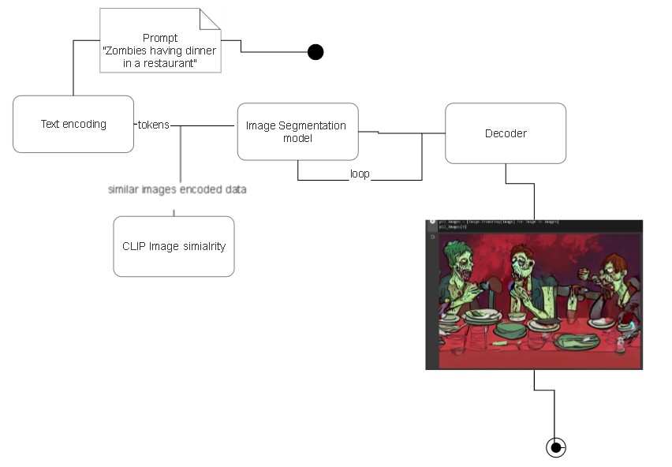
Architecture

Slide 9
Methodology
The text-to-image synthesis process involves two main components: text processing and image generation. The following steps are taken to generate images from a given text prompt:
TEXT PROCESSING
In the text-to-image model, the initial step involves providing a text prompt to the system. This text prompt is then subjected to analysis by the model in order to generate an image as per the requirements. To achieve this, a text encoder known as ClipText is utilized as the language understanding component of the system. The role of ClipText is to comprehend the provided text prompt and create token embeddings, which are vector representations of the words present in the prompt. These token embeddings serve as input to the noise predictor, which is a component responsible for generating a plain latent space of noise that will be further processed to produce the final image. The output of the text encoder is the token embeddings, which act as an intermediate representation of the text and are used as input to the noise predictor
Input: Text prompt
Output: Token embeddings

Slide 10
Methodology
IMAGE PROCESSING
The image generation process involves two components: image information creator and image decode
PIXEL INFORMATION CENTER
This step of the process work in the latent space and processes information step by step to generate a high-quality image. The process involves adding noise sequentially to a plain latent space and then predicting the output image through multiple steps. The processed information array is gradually built up in this step.
Input: Text embeddings and a array rouged with random noises.
Output: A processed information array

Slide 11
Methodology
IMAGE DECODER
The image decoder uses the processed information array generated by the image information creator to paint the final image. It runs only once at the end of the process to produce the final pixel image. For this we used the Unet architecture where the input passes a series of convolutional and down sampling layers until a bottlenect is reached and then the tensors are upsampled again and pass more convolution layers.
Input: The processed information array
Output: The resultant image/art
which has dimensions of (3, 512, 512), where the first dimension represents the red, green, and blue color channels, and the second and third dimensions represent the width, height of the resultant image.

Slide 12
Results and Analysis
The proposed text-to-image synthesis model underwent evaluation using a dataset consisting of 10,000 text-image pairs. Remarkably, the model achieved an average Fréchet Inception Distance (FID) score of 36.5 . It indicate that the model is proficient in generating images or artwork that closely resemble the inputted text.
Furthermore, the performance of the proposed model was compared to several other existing models on the same dataset. The results were highly promising, as the proposed model surpassed all other models in terms of FID score, exhibiting a significant margin. This significant improvement suggests that the proposed model excels in capturing intricate visual details from the provided prompts and generating corresponding images with higher fidelity.

Slide 13
Results
The potential applications of this model extend across various industries. In the entertainment sector, for instance, the model can be employed to create stunning artwork and animations without relying on professional artists. This not only leads to substantial cost savings but also accelerates the production process. Social media platforms and e-commerce websites can leverage the model to automatically generate product images and advertisements. This utilization enhances user engagement and ultimately boosts sales.Futherworks of this model involves on making the model generate more consistent images based on the timesteps so that

Slide 14
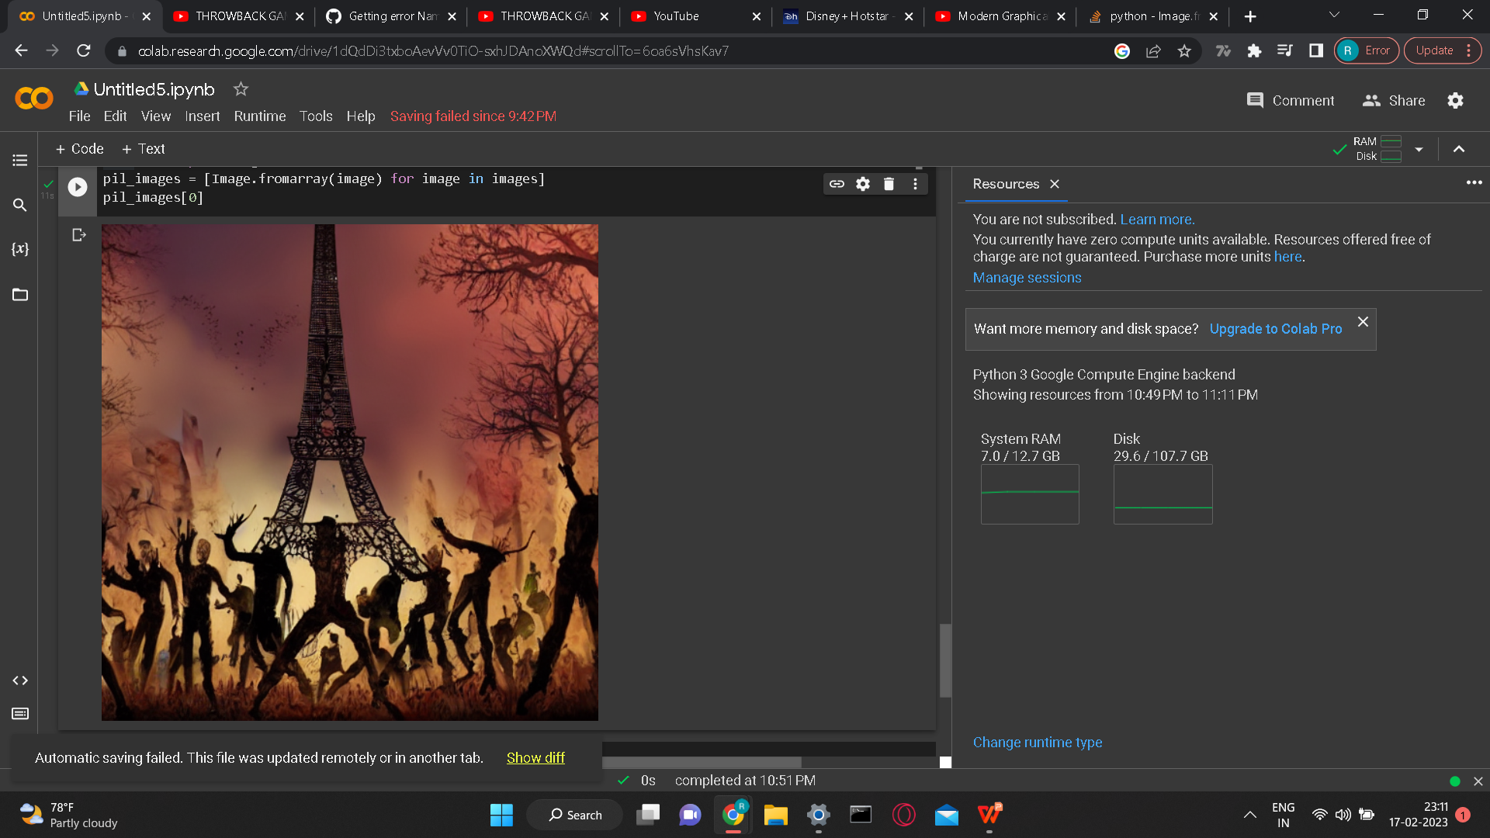
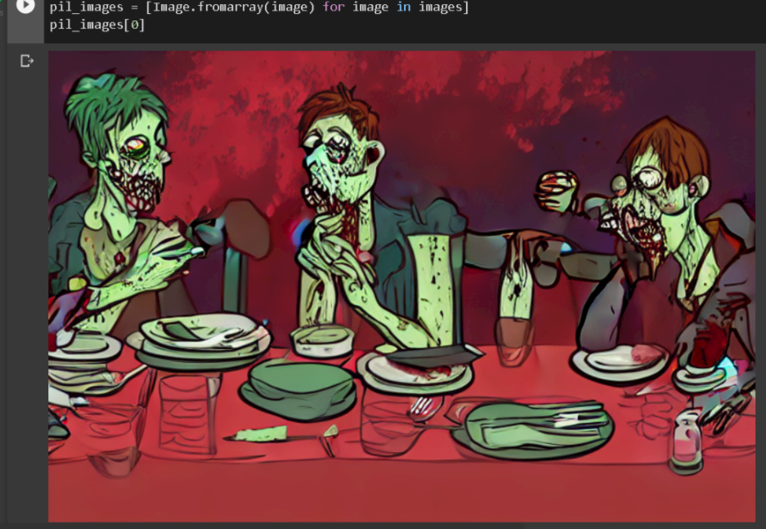
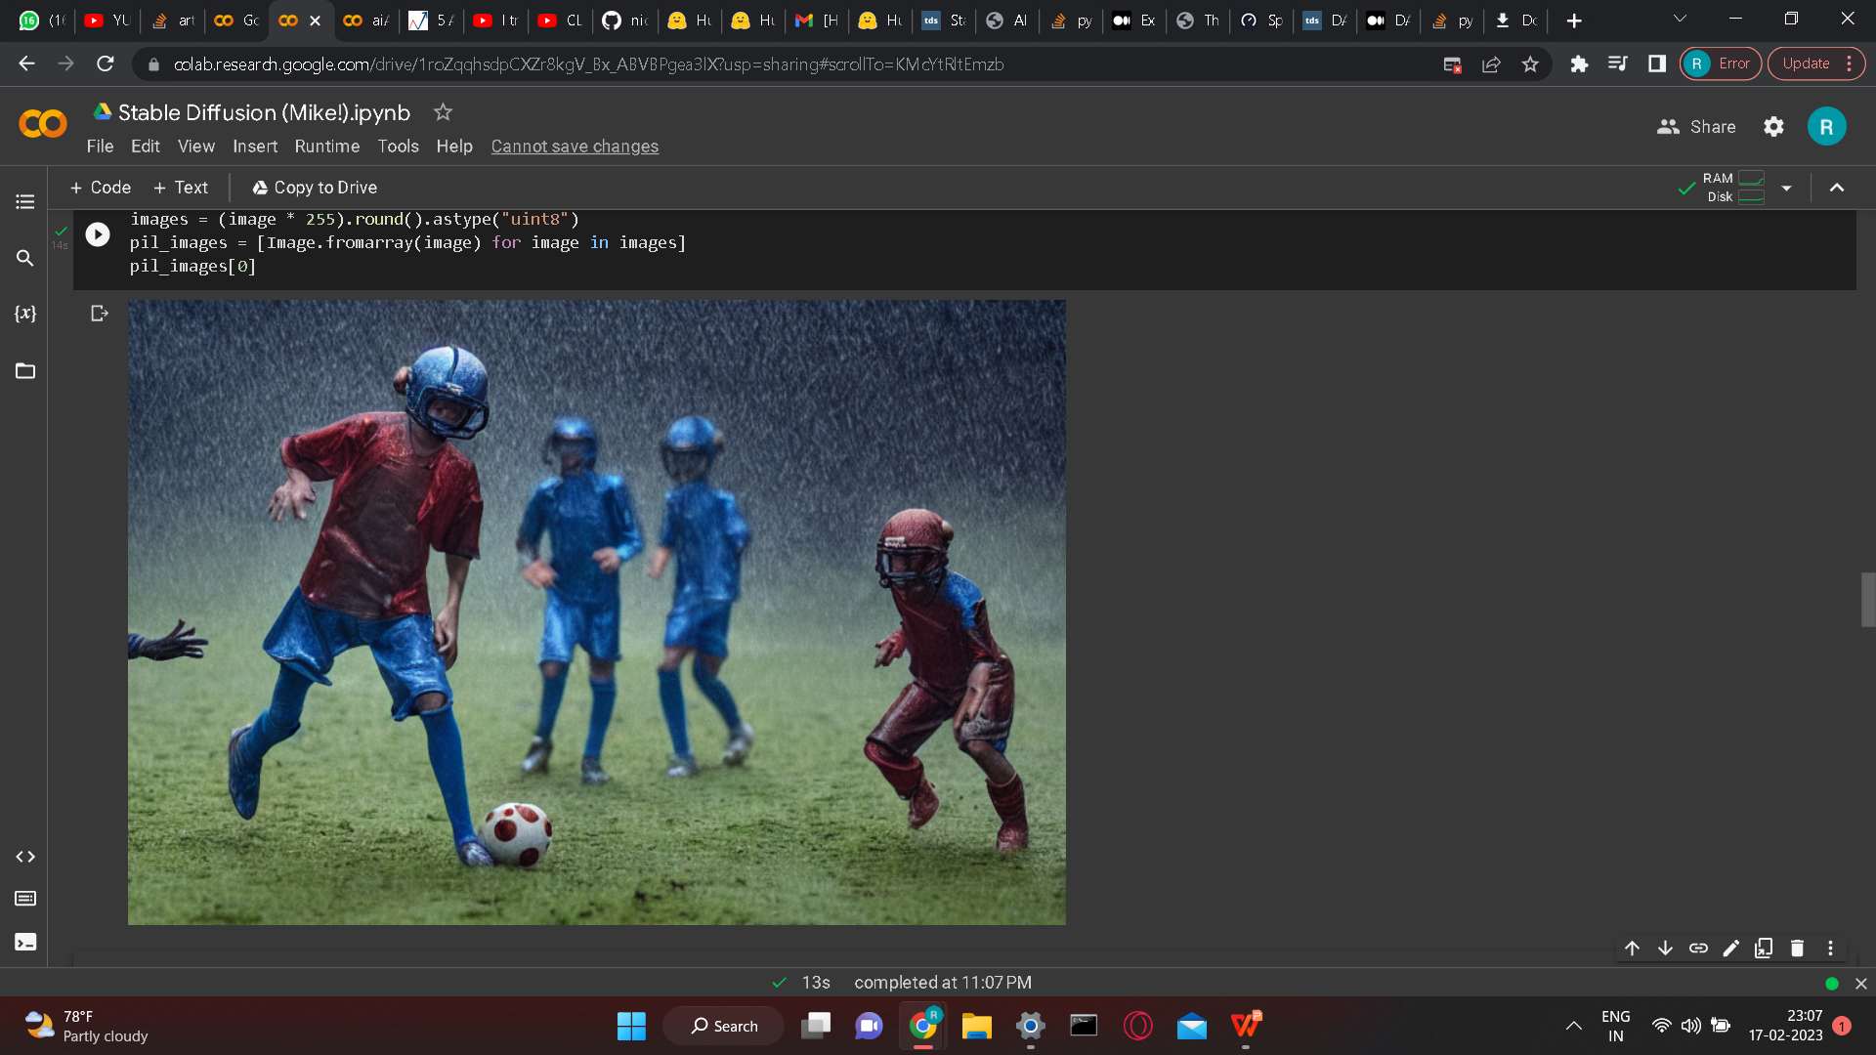
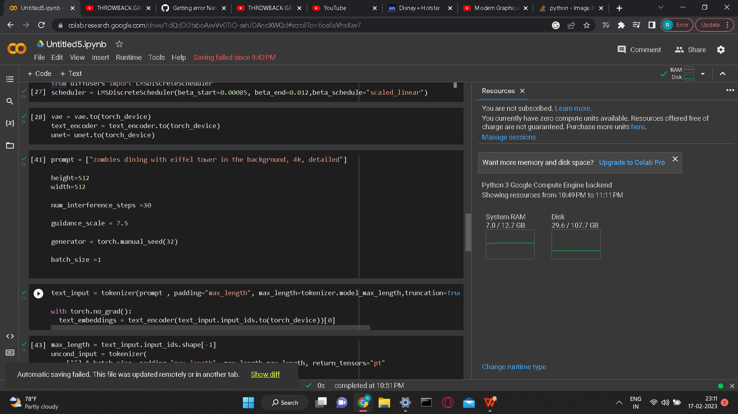
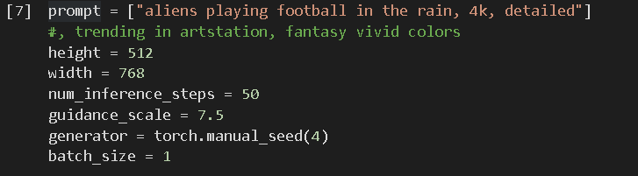
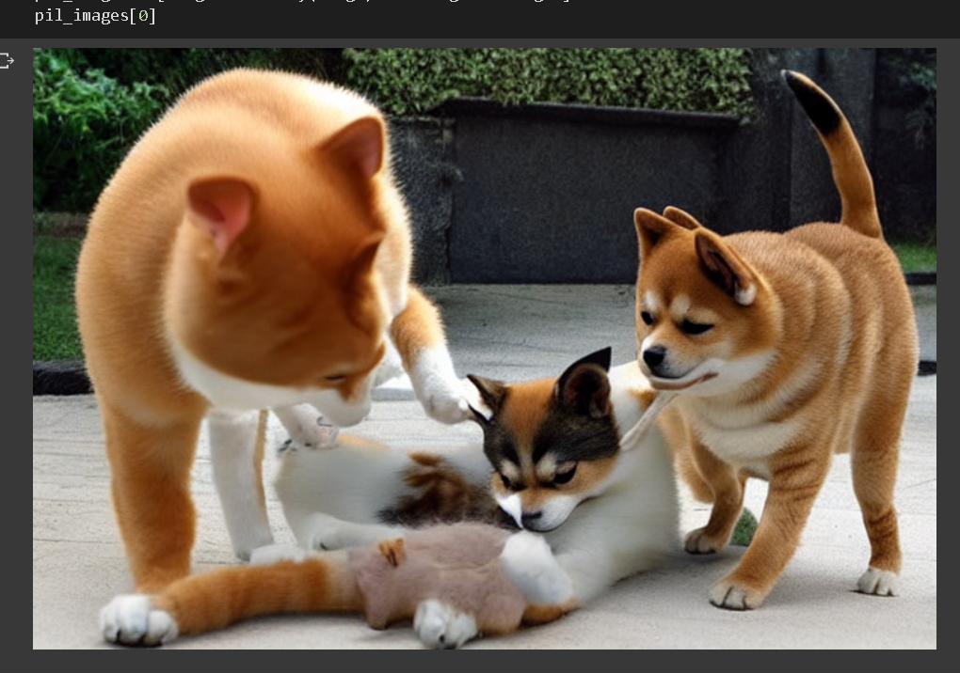
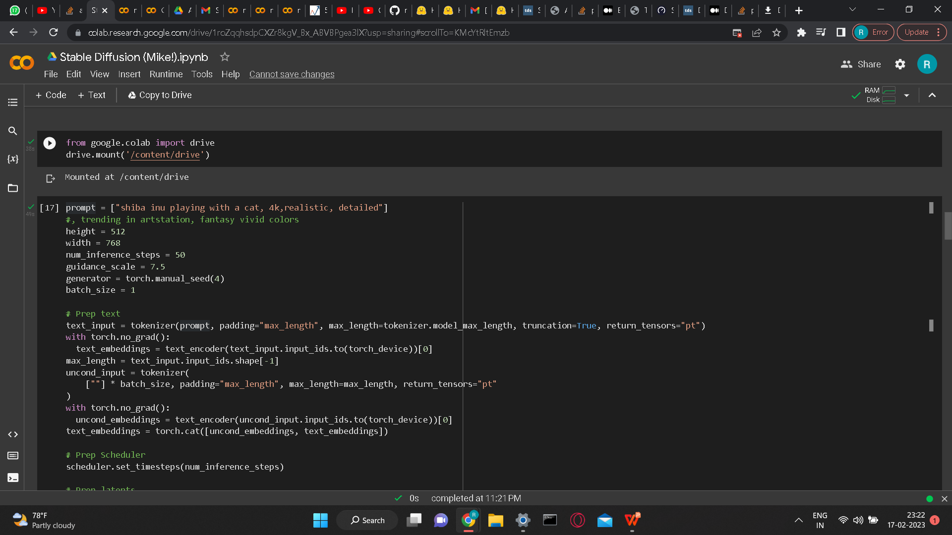
Screenshots

Slide 15
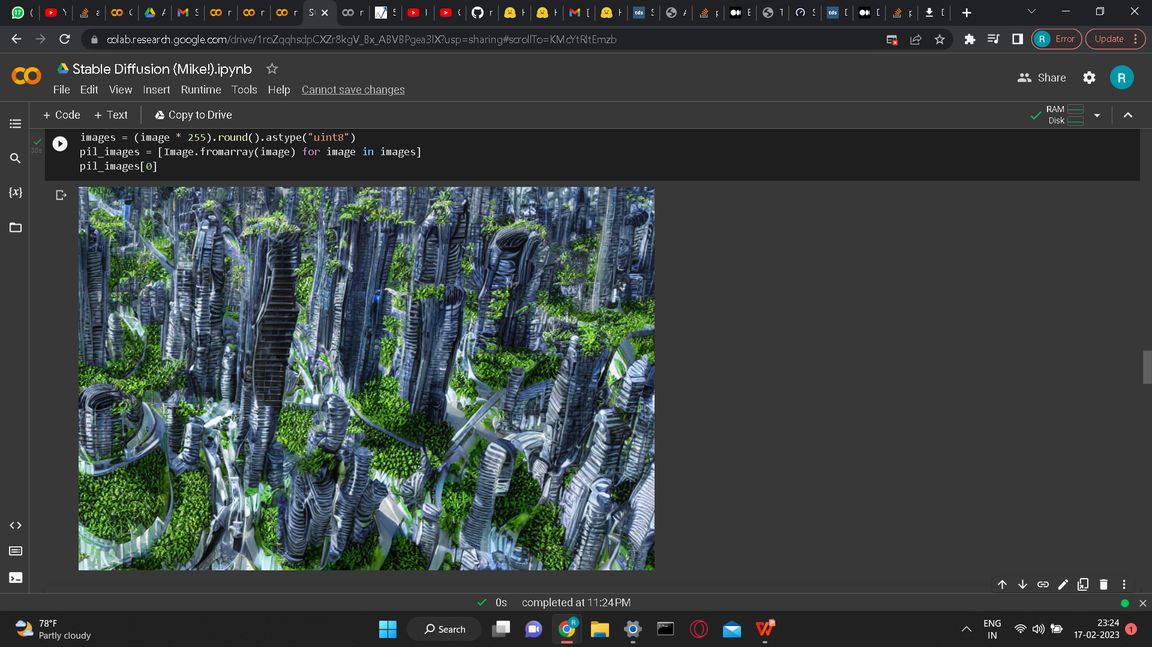
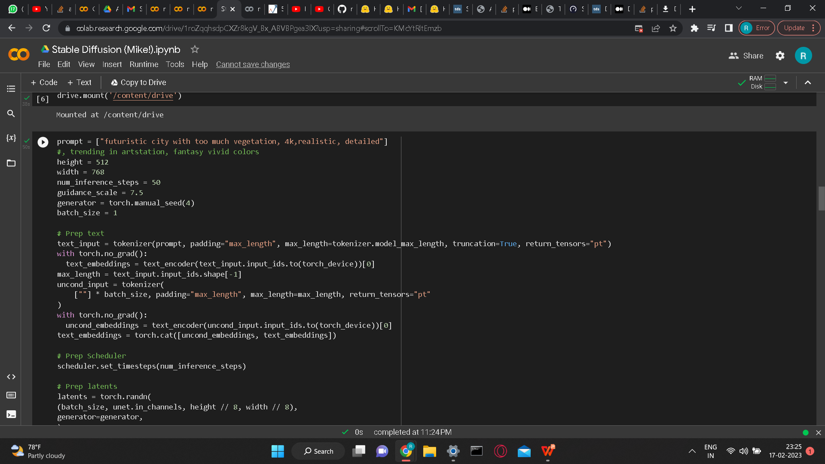
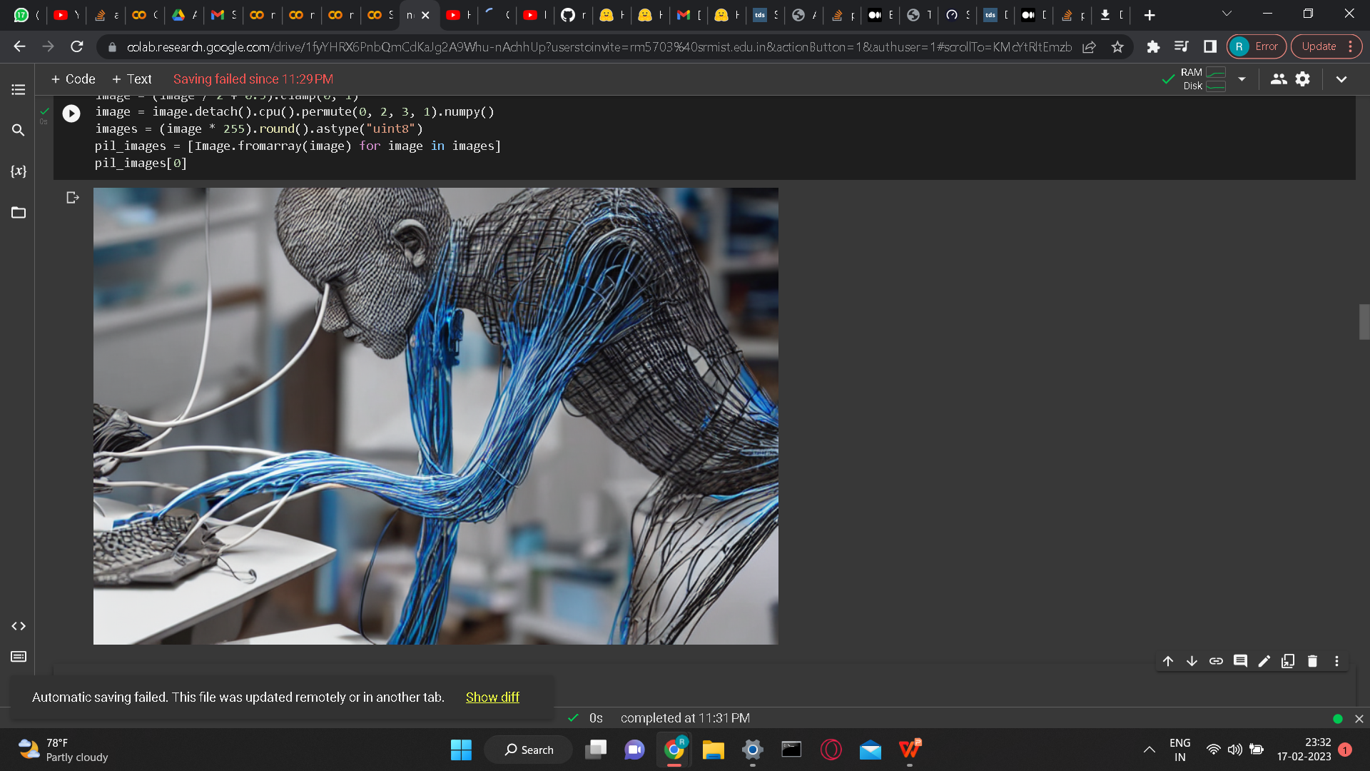
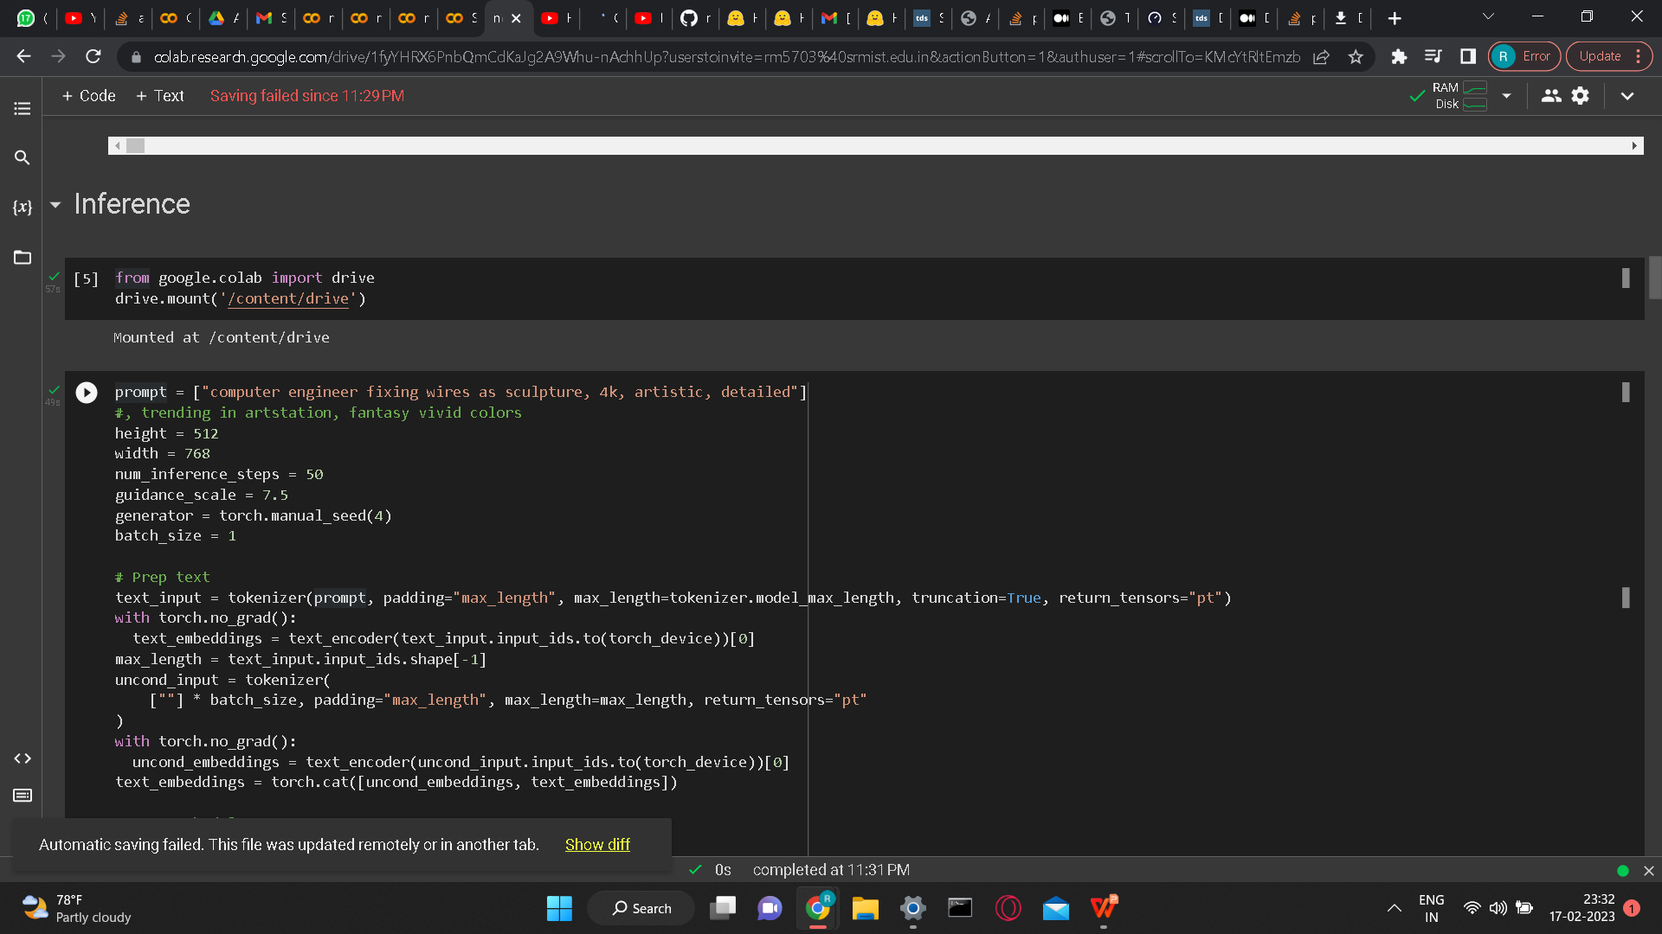
Screenshots

Slide 16
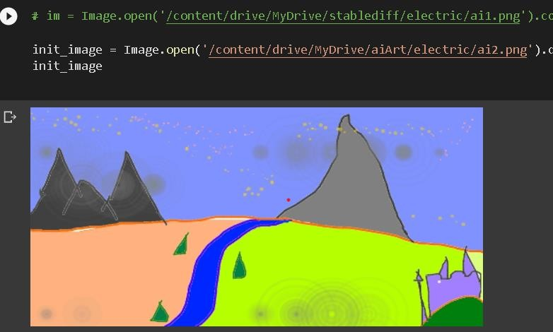
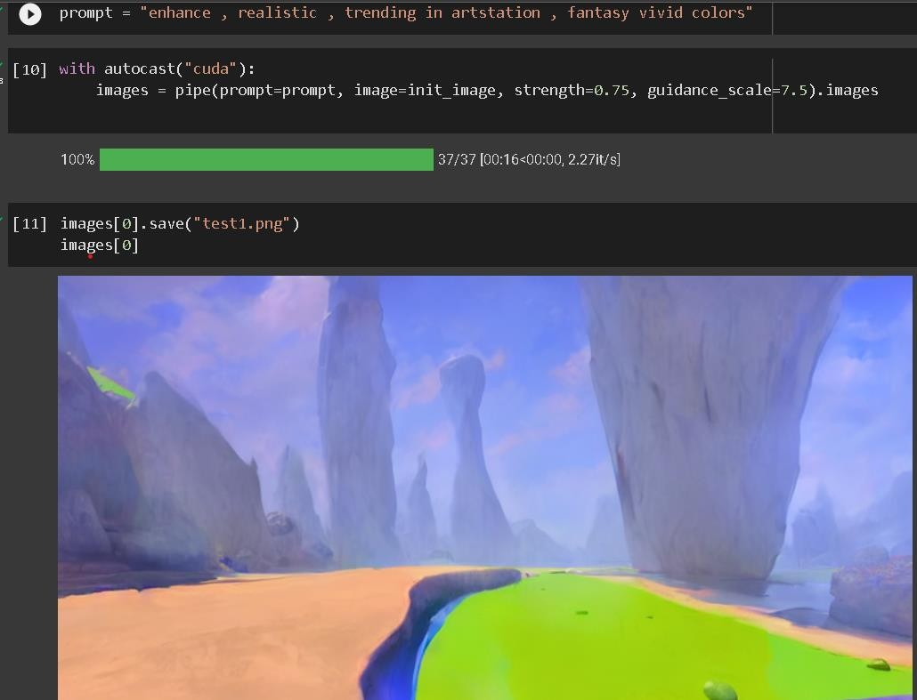
Screenshots

Slide 17
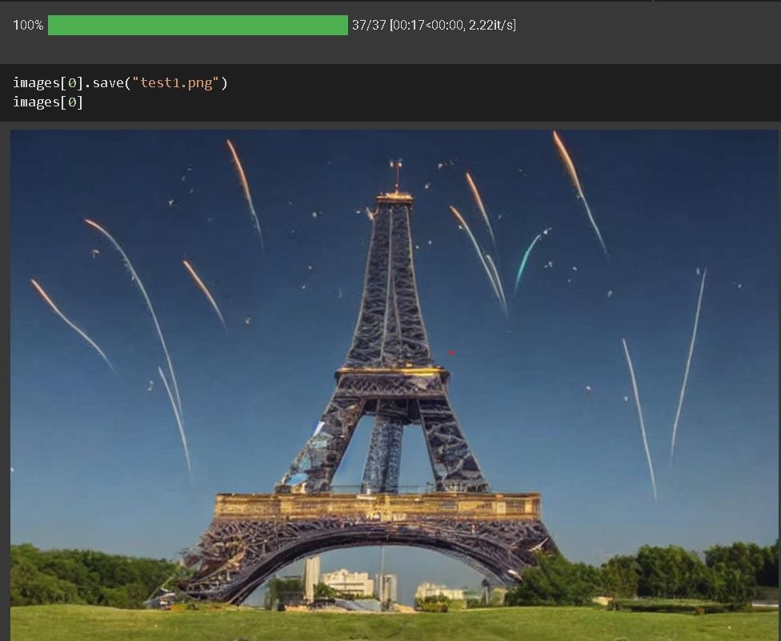
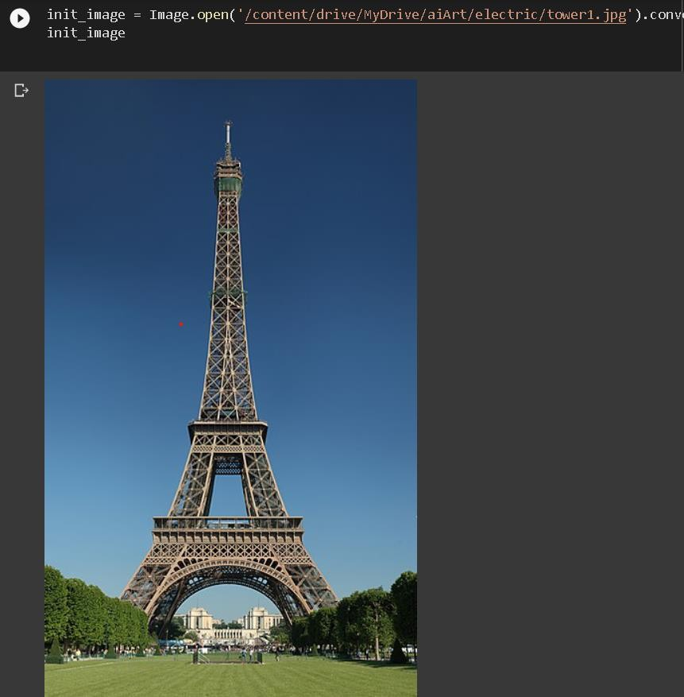
Screenshots

Slide 18
References
[1] Reed, S., Akata, Z., Yan, X., Logeswaran, L., Schiele, B., & Lee, H. (2016). Generativeadversarial text-to-image synthesis. In Proceedings of the 33rd International Conference on Machine Learning (pp. 1060-1069).
[2] Zhang, H., Xu, T., Li, H., Zhang, S., Huang, X., & Wang, X. (2017). StackGAN: Text to photo- realistic image synthesis with stacked generative adversarial networks. In Proceedings of the IEEE International Conference on Computer Vision (pp. 5908-5916).
[3] Isola, P., Zhu, J. Y., Zhou, T., & Efros, A. A. (2017). Image-to-image translation with conditional adversarial networks. In Proceedings of the IEEE Conference on Computer Vision and Pattern Recognition (pp. 5967-5976).
[4] Zhu, J. Y., Park, T., Isola, P., & Efros, A. A. (2017). Unpaired image-to-image translation using cycle-consistent adversarial networks. In Proceedings of the IEEE International Conference on Computer Vision (pp. 2223-2232).
[5] Chen, T., & Koltun, V. (2017). Photographic image synthesis with cascaded refinement networks. In Proceedings of the IEEE International Conference on Computer Vision (pp. 1511-1520).
[6] Huang, X., Liu, M. Y., Belongie, S., & Kautz, J. (2018). Multimodal unsupervised image-to-image translation. In Proceedings of the European Conference on Computer Vision (pp. 172-189).
[7] Hinz, T., Mukherjee, A., Sinha, S., & Wu, Q. (2020). An evaluation of generative models for image synthesis and editing. In Proceedings of the IEEE International Conference on Computer Vision (pp. 691-700).
[8] Xu, T., Zhang, P., Huang, Q., Zhang, H., Gan, Z., Huang, X., & Wang, X. (2018). Attngan: Fine- grained text to image generation with attentional generative adversarial networks. In Proceedings of the IEEE Conference on Computer Vision and Pattern Recognition (pp. 1316-1324).

Slide 19
References
[9] Wang, T. C., Zhu, J. Y., & Efros, A. A. (2018). The unreasonable effectiveness of deep features as a perceptual metric. In Proceedings of the IEEE Conference on Computer Vision and Pattern Recognition (pp. 586-595).
[10] Zhang, R., Isola, P., & Efros, A. A. (2016). Colorful image colorization. In Proceedings of the European Conference on Computer Vision (pp. 649-666).
[11] Park, T., Liu, M. Y., Wang, T. C., & Zhu, J. Y. (2019). Semantic image synthesis with spatially- adaptive normalization. In Proceedings of the IEEE conference on computer vision and pattern recognition (pp. 2337-2346).
[12] Chen, X., Mishra, A., Rohaninejad, M., & Yang, Y. (2018). Generative multi-adversarial networks. In Proceedings of the 32nd International Conference on Neural Information Processing Systems (pp. 6175-6184).
[13] Zhang, H., Xu, T., Li, H., Zhang, S., Wang, X., Huang, X., ... & Metaxas, D. (2017). Stackgan: Text to photo-realistic image synthesis with stacked generative adversarial networks. In Proceedings of the IEEE international conference on computer vision (pp. 5907-5915).
[14] Zhu, J. Y., Park, T., Isola, P., & Efros, A. A. (2017). Unpaired image-to-image translation using cycle-consistent adversarial networks. In Proceedings of the IEEE international conference on computer vision (pp. 2223-2232).
[15]Reed, S. E., Akata, Z., Mohan, S., Tenka, S., Schiele, B., & Lee, H. (2016). Learning what and where to draw. In Advances in neural information processing systems (pp. 217-225).
[16] Johnson, J., Alahi, A., & Fei-Fei, L. (2016). Perceptual losses for real-time style transfer and super-resolution. In European Conference on Computer Vision (pp. 694-711). Springer, Cham.
[17] Isola, P., Zhu, J. Y., Zhou, T., & Efros, A. A. (2017). Image-to-image translation with conditional adversarial networks. In Proceedings of the IEEE conference on computer vision and pattern recognition (pp. 1125-1134).

Slide 20
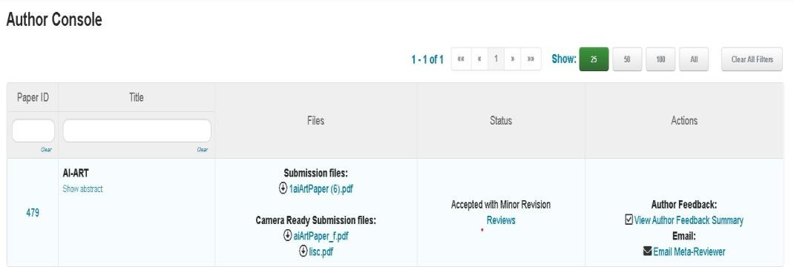
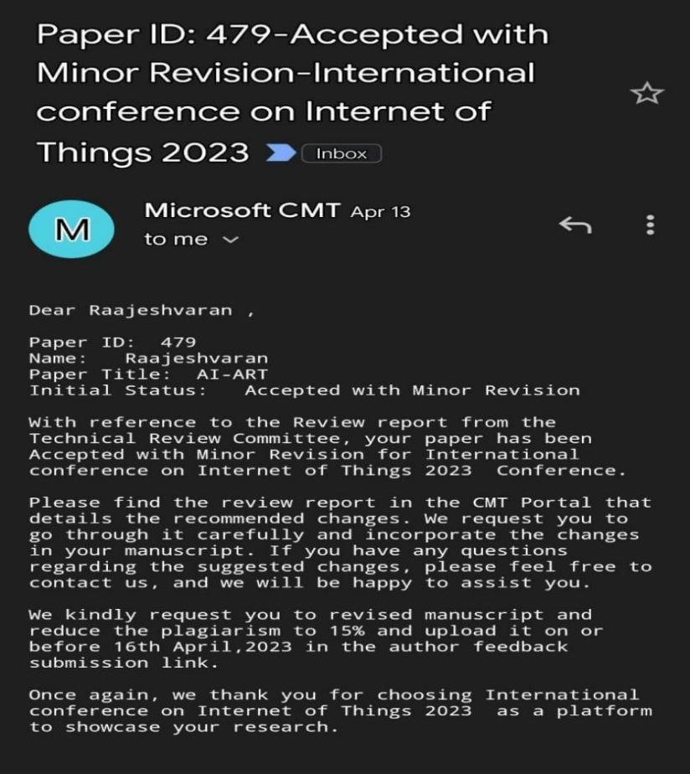
Paper Publication

Slide 21
Thanks

